Slide 1

River Valley Community College
Associate of Science Degree in Nursing
Informational Session Presentation

Slide 2


Introduction
We are one of nine associate-degree nursing programs in New Hampshire.
Our Associate of Science in Nursing (ASN) program was founded in 1981.
We are accredited by the Accrediting Commission for Education in Nursing (ACEN) for our Associate of Science Degree in Nursing (ASN) program.

Slide 3
Associate of Science in Nursing - Program Details
The pre-licensure Associate in Science Degree in Nursing (ASN) program for students with no previous nursing experience requires requisite courses and 2 years of focused nursing courses.
Upon successful completion of the program and general education coursework, students will earn an ASN degree and will be eligible to apply for the RN licensure exam (NCLEX-RN).

Slide 4
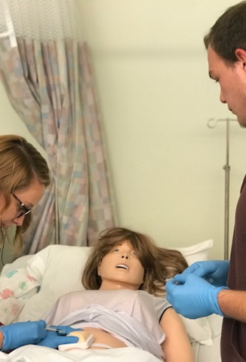
About RVCC Nursing
In the last 3 years, we have had greater than a 90% pass rate for the National Council Licensure Exam (NCLEX-RN).
In 2018 and 2019, we have had a 100% pass rate for the NCLEX-RN! 2020 pass rate information is pending.
Our job placement rates for our RN nursing graduates is also 100%.
Our Associate in Science in Nursing program offers classes both in Claremont and Keene. At present, we accept students every year in Claremont, and every other year in Keene (even entrance years – i.e., 2020, 2022, etc.).

Slide 5
Nursing Program Outcomes
The first-time pass rate for RVCC nursing graduates is equivalent to, or exceeds the national pass rate for first-time test takers who are graduates of associate degree nursing programs.
Eighty percent (80%) of students will graduate from the RVCC Nursing Program within 3 years of the initial admission into the program.
Within six months of graduation from the RVCC nursing program, 90% of graduates will be employed as Licensed Practical or Registered Nurses.

Slide 6
ASN Course MAP
FALL
S P R I N G
F A L L
S P R I N G
COURSE # | COURSE NAME | PRE/COREQUISITES | CREDITS
BIOL 201R | Anatomy & Physiology I | High School Chem. | 4
PSYC 101R | Intro. to Psychology |  | 3
ENGL 102R | College Composition |  | 3
ADNR 105R | Nursing Seminar I | ADNR 116R | 1
ADNR 116R | Nursing Care I | ADNR 105R All above courses | 7
COURSE # | COURSE NAME | PRE/COREQUISITES | CREDITS
BIOL 202R | Anatomy & Physiology II | BIOL 201R | 4
PSYC 114R | Human Development |  | 3
Math | Math Elective |  | 3/4
ADNR 117R | Nursing Care II | ADNR 116R, 105R All above courses | 9
COURSE # | COURSE NAME | PRE/COREQUISITES | CREDITS
BIOL 205R | Microbiology | BIOL 201R | 4
ADNR 220R | Nursing Care III | ADNR 117R, 105R All Above Courses | 9
COURSE # | COURSE NAME | PRE/COREQUISITES | CREDITS
Humanities, F/A, Language, | Humanities Elective |  | 3
ADNR 235R | Nursing Seminar II | ADNR 117R ADNR 105R | 1
ADNR 230R | Nursing Care III | ADNR 117R, 105R All Above Courses | 9

Slide 7

ASN Application process
Step 1: Complete RVCC Application and submit high school and college transcripts.
RVCC Application is here: https://www.rivervalley.edu/admissions/welcome/
Step 2: Register to take the TEAS test
    Students must achieve minimum scores in each of the following areas:
    Reading-73.8; Math-70.0; Science-52.1; English-63.3
Step 3: Review information in this presentation.
In order to be eligible for priority acceptance, please complete steps 1-3 by December 31 of the year prior to program entry.
Student selection is highly competitive.

Slide 8

Other ASN Logistics
If accepted, students will be notified by March 1 of program entry year.
Once accepted, other requirements due by July 1 of program entry year are as follows (do not submit directly to the college – if accepted, you will receive instructions on how to submit to document portal at Castle Branch)
Licensure – current NH licensure as a Nurse Assistant or Practical Nurse.
Basic Life Support Certification– American Heart Association Basic Life Support (BLS) for Healthcare Providers
Medical Documentation - Physical Exam, and miscellaneous required vaccinations
Proof of Medical Insurance – Students are required to carry medical insurance to participate in clinical.

Slide 9
Other ASN Logistics
Once accepted into the program, students will also be required to complete the following:
Criminal Background Record – A NH and federal criminal background record is required. Any fees are at the expense of the student. A history of a felony or selective misdemeanors may deny entrance into the nursing program.
Drug Testing – Drug testing may be required prior to the start of any work-based clinical learning experience. Any fees are at the expense of the student.

Slide 10

ASN Program FAQ’s
1. Will general education courses transfer?
Once RVCC receives official transcripts, a transfer evaluation is completed. All general education courses must be achieved with a grade of “C” or higher. Science courses must be current within the last 10 years.
2. What will my schedule be like?
Students will have laboratory, classroom, and clinical requirements Tuesdays through Fridays each semester, although, depending upon clinical site availability, Mondays and Saturdays may be used. This schedule is non-negotiable.
3. Am I able to work?
Yes; however, it is recommended that you do not work greater than 20 hours per semester.
4. What is the cost to attend RVCC?
Please see this link: https://www.rivervalley.edu/admissions/tuition-fees/tuition-and-fees
5. Are my courses transferrable to a Bachelor’s Degree?
Absolutely! RVCC has some articulation agreements with colleges granting baccalaureate degrees in nursing for reduced cost to RVCC graduates.

Slide 11
LPN vs RN: which is right for me?
LPN | RN
May be completed in as few as 3 semesters | May be completed in as few as 4 semesters
Certificate/diploma when complete | Associate’s Degree when complete
NCLEX-PN for licensure | NCLEX-RN for licensure
Scope of Practice: Collects medical data and contributes to the care of the patient by providing treatments, medications, and care under the supervision of a doctor or registered nurse | Scope of Practice: Assessing and diagnosing the health status of a client; plans, implements, and evaluates client care and is able to practice autonomously
*Annual salary in NH: $40k - $60k | *Annual salary in NH: $47k –$87k
Q: What is the difference between and RN and an LPN?
If you are interested in pursuing an LPN certificate, details are here:
https://www.rivervalley.edu/program/nursing-licensed-practical-nurse-lpn/

Slide 12
ASN Selection Criteria
How are students selected?
  As indicated, selection is highly competitive and is based upon a point system.
  Students are awarded points for completion of Anatomy/Physiology I, Anatomy/Physiology II, and Microbiology, prior to program entrance, with higher grades earning more points. Science courses must be within the past 10 years of program entrance.
  High school/college GPA is also evaluated.
  Students are also evaluated on ATI TEAS composite scoring.
  TEAS scores from the past 2 years prior to program entrance are considered.
  Students may re-take the TEAS test to increase scores in any one of the 4 content areas, and/or to improve overall composite scoring. RVCC takes the last 2 consecutive ATI test scores and takes the highest in each section for selection.

Slide 13
Overall ASN FAQ’s
Q: What else do I need to know?
A. When you apply to the ASN program, indicate that you are a Healthcare Applications student. By doing this, you will have access to financial aid, academic advisors, and can start taking corequisite courses.
Taking any corequisite courses before starting the nursing program can help reduce your nursing program course workload.
Begin preparing to take the TEAS; there are free resources in our library!

Slide 14
The TEAS Test

Slide 15

TEAS = Test of Essential Academic Skill

Slide 16
The TEAS Test
The TEAS is a Nursing Entrance Exam.
Objectives assessed on the TEAS exam are those which nurse educators deemed most appropriate and relevant to measure entry level skills and abilities of nursing program applicants.
It covers broad and varied areas of subject matter.
Students must score at or above the minimum score in the following areas for the ASN program:
Reading-73.8; Math-70.0; Science-52.1; English-63.3
RVCC takes the last 2 consecutive ATI test scores and takes the highest in each section for selection.

Slide 17
Composition of the TEAS Test
170 multiple-choice questions in 4 areas:
Reading
Math
Science
English and Language Usage
209 minutes in length (3 hours, 29 minutes)

Slide 18
 | Reading | Mathematics | Science | English and Language Usage
Number of Questions | 53 | 36 | 53 | 28
Time Limit (Minutes) | 64 min | 54 min | 63 min | 28 min
Specific Content Covered | Key ideas and details Craft and structure Integration of knowledge & ideas Pre-Test questions | Numbers and algebra Measurement and data Pre-Test questions | Human anatomy & physiology Life and physical sciences Scientific reasoning Pre-Test questions | Conventions of standard English Knowledge of language Vocabulary acquisition Pre-Test questions

Slide 19

Optional Study Resources
TEAS Prep Options with estimated costs https://www.atitesting.com/ati_store/product.aspx?zpid=1528
    ATI SmartPrep Study Package - $209 – unlimited 90-day online usage of SmartPrep Course, Study Manual, 650 sample questions, and 2 practice TEAS tests (150 questions each)
    ATI TEAS Basic Package ­- $115 – Study Manual and 2 practice TEAS tests (150 questions each)
    ATI TEAS Online Assessment Package - $82.80 – 2 practice TEAS tests (150 questions each)
    ATI Practice Assessment A or B - $46.00 – 1 practice TEAS test (150 questions each)
Kaplan Test Prep – ATI Teas Strategies book – average cost $25 -ISBN: 978-1506211152
ED2Go Self-Paced Tutorials – Reading and English Portions: $115; Math and Science Portions - $115 - https://www.ed2go.com/rivervalley/SearchResults.aspx?SearchTerms=teas
It is HIGHLY recommended you utilize a TEAS prep resource prior to taking the TEAS to increase your likelihood of success!
19

Slide 20

Further Study Resources – Available in RVCC’s Library
The RVCC library has help with test preparation for sections of the official entrance exams required by major health education programs, such as the TEAS (Test of Essential Academic Skills) in the Learning Express Library.
TEAS Resources
Nursing School Entrance Exams, 4th Edition
Nursing School Practice Entrance Tests 1 & 2:
• Biology
• Chemistry
• General Science
• Math Ability
• Reading
• Verbal Ability
Ask your Librarian about LearningExpress Test Prep!

Slide 21
How to Register for the TEAS Test
Go to atitesting.com
Follow instructions and create a user name. Cost is $100 per TEAS test. Your results are provided to you immediately after the TEAS test.
If taking the TEAS remotely due to COVID-19, you will need to have Proctorio proctoring software downloaded to your computer. Download instructions are on our website: https://www.rivervalley.edu/program/nursing/
Sample TEAS practice tests can be located here:
https://www.testprepreview.com/teas_practice.htm

Slide 22
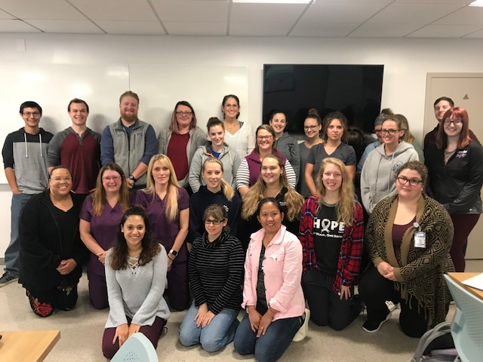
Your Next Steps
If interested, please register as a General Studies Explorer student at RVCC, so that you are assigned an academic advisor and then also will be eligible for financial aid.
Begin studying and register for the TEAS test
Obtain New Hampshire Licensed Nursing Assistant licensure (RN).
Work through requirements as previously discussed.
For further, program-specific information, please contact: sgroenewold@ccsnh.edu.
Get a pulse on your future, and jump start your career in nursing at RVCC!

